Slide 1
Workplace Net Zero Carbon and Sustainability Management Programme. The Institute of Leadership and Management Accredited.
By GreenPad Enterprise

Slide 2
Introduction
Welcome to the first module of the Workplace Net Zero Management Programme Series. In this module, you will learn the following:
What ‘Net Zero’ means to workplaces
The meaning of environmental sustainability in the workplace and what it is for a business like yours to achieve true environmental sustainability
How environmental sustainability is critical to ‘Net Zero’ at workplaces
The driving force behind the demand for business environmental sustainability in today’s world

Slide 3
Introduction
At the end of the module, we will summarise the key points
You will then take a quick assessment to ensure that you remember what you have learnt

Slide 4

How can Net Zero be understood in a work environment?
The world is in a climate change era.
This means that there are changes in climatic conditions across the globe, creating negative environmental issues like droughts, wildfires, floods, sea-level rise, hurricanes and much more.
These changes have been scientifically traced to increasing greenhouse gas emissions in the environment.
Greenhouse gases such as carbon dioxide, methane, water favour, nitrogen dioxide, hydrofluorocarbons, perfluorocarbons and sulphur hexafluoride trap heat in the atmosphere and prevent them from escaping into space.

Slide 5
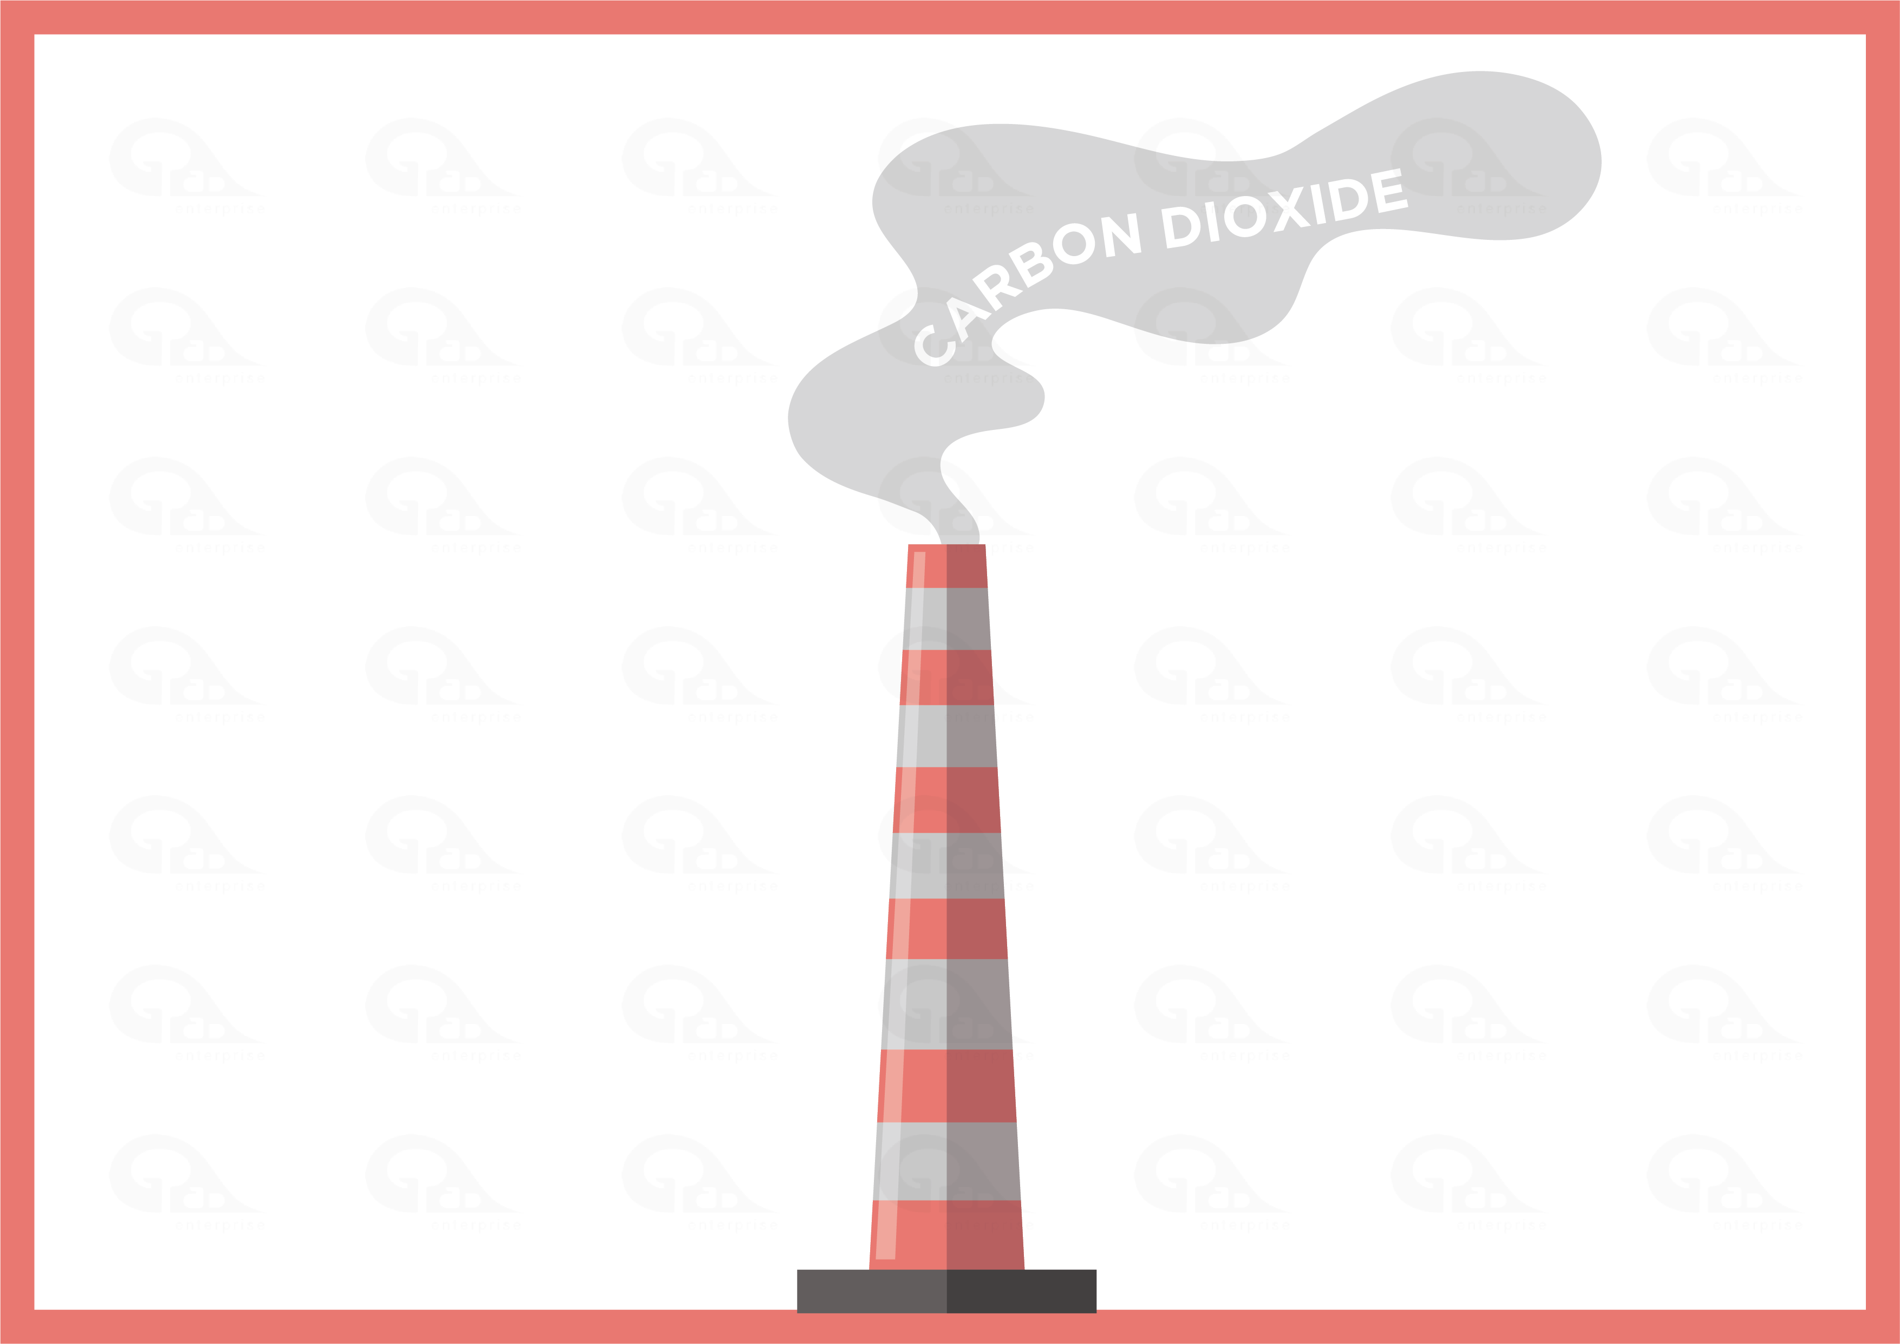
How can Net Zero be understood in a work environment?
Given that carbon dioxide is the most common greenhouse gas, these emissions are expressed in terms of their carbon equivalent and are referred to as the carbon footprints of an organisation.
To combat climate change, governments around the world are committing to net zero targets. For example, the United Kingdom has a 2050 net zero carbon target. This means that by 2050, the amount of greenhouse gases that the United Kingdom will be removing from the atmosphere will be higher or equal to what the country will be producing.
As a result of governments commitments to net zero, organisations across global economies are now required to take steps to get as close to zero carbon emissions as possible.

Slide 6

What does environmental sustainability management mean?
You can think of environmental sustainability at your workplace as the process of carrying out your daily operational duties in a responsible manner that considers the environment. For example, when you use energy and water responsibly at your workplace, you are saving the environment by limiting your organisation’s energy and water consumption carbon emissions and this will help in protecting the future environmental resource needs of others.
Our planet has natural beauty and environmental resources. With the right attitude to environmental matters, we can achieve the goal of creating a better planet for ourselves.

Slide 7
Why environmental sustainability is critical to Net Zero at workplaces?
It is important to note that the daily operations of your workplace can interfere or have either an adverse or beneficial effect on the environment.
The essence of environmental sustainability management at workplaces is to ensure that the environment is managed efficiently during all business transactions, whether on an individual or organisational level.
The thinking is that if our environment is well managed in the we operate at work, there will be less carbon emissions from our operations and we can achieve net zero someday.

Slide 8
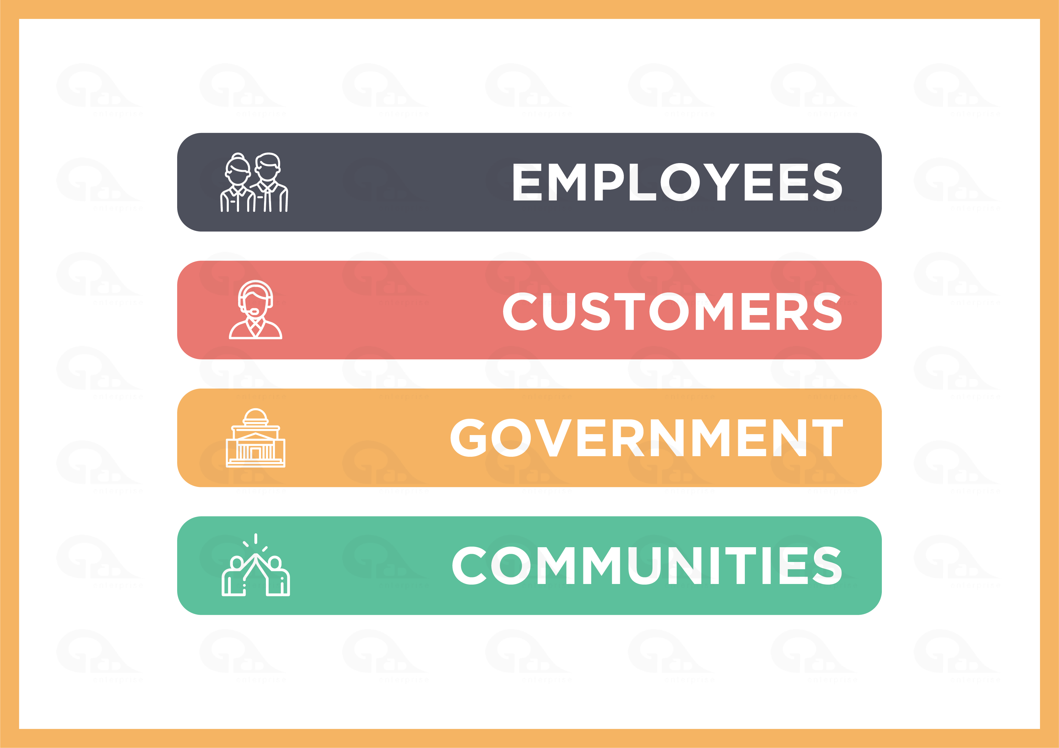
Who needs organisations to be environmentally sustainable to achieve Net-Zero?
The environmental challenges, and in particular climate change, accompanying the advancement of businesses in the 21st century have become a hot topic for discussion across several sectors of the economy. This has resulted in the rising demand for environmental sustainability considerations from some sources such as:
Employees
Customers or end-users
Governments
Communities/Society

Slide 9
Who needs organisations to be environmentally sustainable?
Employees: Employees are increasingly aware of the happenings and events in the environment. To retain talents, organisations must be seeing to be doing their bits for the environment. In the same vein, there are pools of high talents in the job market that are selective on the type of organisation to be associated with.
There are research findings that show a close correlation between a sustainable workplace environment and job satisfaction.
Customers or end-users: Organisation consumers or end -users are becoming more environmentally conscious. They have begun to further demand sustainable products and services. Consequently, organisations stand the risk of losing customers or end -users if they operate in an environmentally unsustainable way that increases their carbon emissions.

Slide 10
Who needs organisations to be environmentally sustainable to achieve Net-Zero?
Government: Governments worldwide are finding better ways of protecting the environment and demanding that organisations operate sustainably to reduce carbon emissions. Governments’ increasing commitment to sustainability is supported by policies and standards that require the adherence of organisations to improve the environment.
Communities/Society: Communities globally are making environmental sustainability demands from private and public sector businesses for continued cooperation. Businesses that do not demonstrate or contribute to environmental sustainability within their communities are not seen to have community interests at heart. This can create a negative outlook for the organisation as they could be seen as being driven solely by profits without care for ethics.

Slide 11
What role do I have in my workplace environmental sustainability and Net-Zero journey?
It is imperative to note that your workplace cannot achieve environmental sustainability and Net-Zero if actions are not taken to manage ad balance environmental issues in how you and your colleagues operate.
This means that the environmental impact of your daily activities at work should be aptly considered to ensure the most efficient approach is always taken.
For example, in the consumption of energy, you should consider the environmental sustainability of your workplace and use electricity considerately to protect the planet.

Slide 12

In this module, workplace environmental sustainability management is explained as the things you and your colleagues do to meet your daily operational needs (such as the responsible use of energy and water) at work whilst considering the environment. The essence of environmental sustainability management at workplaces is to ensure that the environment is managed and improved during all business transactions and decisions taken, be it on an individual or organisational level to reduce carbon emissions.
Organisations are under increasing pressure from stakeholders such as customers or end-users, governments and communities to manage their operational environment impacts to reduce carbon emissions and they risk losing stakeholders’ trust and cooperation if they do otherwise.

